Slide 1
Weekly update
NYSE delisting analysis

Slide 2
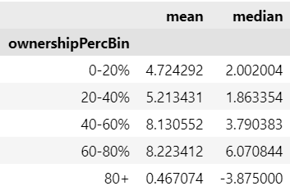

30-day returns at the $5 price level
Monotonically increasing except for stocks with more than 80 percent institutional ownership
Num obs.
Returns are in %

Slide 3
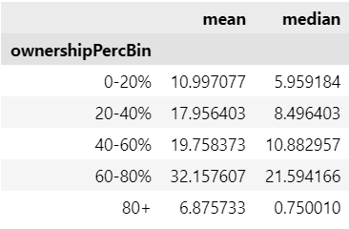

90-day returns at the $5 price level
Monotonically increasing except for stocks with more than 80 percent institutional ownership
Num obs.
Returns are in %

Slide 4
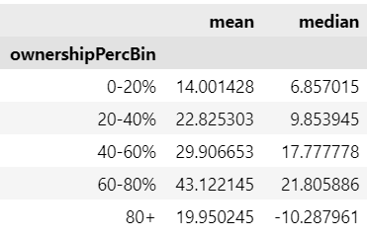

180-day returns at the $5 price level
Monotonically increasing except for stocks with more than 80 percent institutional ownership
Num obs.
Returns are in %

Slide 5

Generating test data
Generating Fama French three factor data: (Daily returns)
$Mkt−rf = 0.05/365 + noise$
$SMB=0.01/365+noise$
$HML=0.03/365+noise$
Stock returns
$R_{s}=alpha+β_{m }∙(Mkt−rf)+β_{smb}∙ SMB+β_{hml} ∙ HML+rf +noise$

Slide 6
Results
When noise = 0; All algorithm outputs match generated data
Ownership Bins | E(r) 30-day | Algorithm output
0-20% | 0.742 | 0.742
20-40% | 0.874 | 0.874
40-60% | 1.074 | 1.074
60-80% | 0.676 | 0.676
80% + | 0.742 | 0.742

Slide 7
Next steps
Try making a hedged portfolio which is long a stock of interest and short the Fama French three factors.

